Slide 1
Semantic Segmentation of Aerial Images of Forest Scenery
Malika Navratna, Urvashi Negi, Zain Ul Haq, Simon Deussen
H-BRS - DLVR - 13.01.22
Notes:
MALIKA

Slide 2
… or how SUMZ-Net broke the dataset.
Malika Navratna, Urvashi Negi, Zain Ul Haq, Simon Deussen
H-BRS - DLVR - 13.01.22
Notes:
MALIKA

Slide 3
Introduction
Deforestation is an increasing problem which affects biodiversity and contributes to global warming
To overcome this, reforestation is being done at a large scale, for eg: by using drones
Finding suitable land for autonomous seeding has to be known
Notes:
URVASHI

Slide 4
Approach
Semantic Segmentation of images for forest and non forest area helps in deciding which area is suitable for seeding
Labelled images captured by drones help in training the model
Notes:
URVASHI

Slide 5
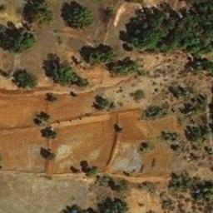
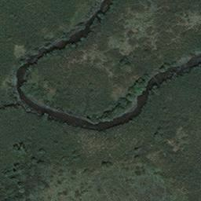
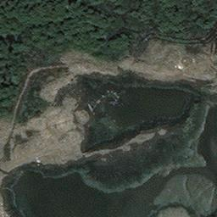
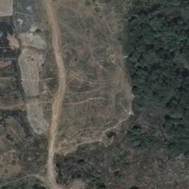
Dataset
Forest Segmentation Dataset
5108 Images (256x256)
Forest/non-forest binary labels
Not the most accurate labels 🤷
kaggle
Notes:
URVASHI

Slide 6

Approach: U-Net
First developed for Biomedical Image Segmentation (Ronneberger 2015)
Fig: U-Net architecture by Ronneberger, 2015
References:
Ronneberger, O., Fischer, P., & Brox, T. (2015, October). U-net: Convolutional networks for biomedical image segmentation. In International Conference on Medical image computing and computer-assisted intervention (pp. 234-241). Springer, Cham.
Notes:
SIMON

Slide 7
ENCODER
Approach: U-Net
Fig: U-Net architecture by Ronneberger, 2015
Notes:
SIMON

Slide 8
BRIDGE
Approach: U-Net
Fig: U-Net architecture by Ronneberger, 2015
Notes:
SIMON

Slide 9
DECODER
Approach: U-Net
Fig: U-Net architecture by Ronneberger, 2015
Notes:
SIMON

Slide 10
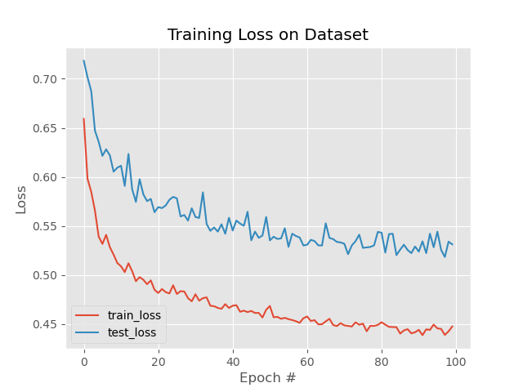
Learning Approaches
Hyperparameters:
Learning Rate
0.00001 - 0.001
Optimizer
Adam
Loss functions:
Binary Cross Entropy
DICELoss (F1 score)
FocalLoss
Notes:
SIMON

Slide 11
Results
Notes:
ZAIN

Slide 12
SUMZ-NET
Ensemble network consisting of three different encoders:
VGG16 & U-NET
Inceptionv3 & U-NET
RESNET34 & U-NET
Made possible using pre-trained image-net weights and a melting gpu…
Notes:
ZAIN

Slide 13
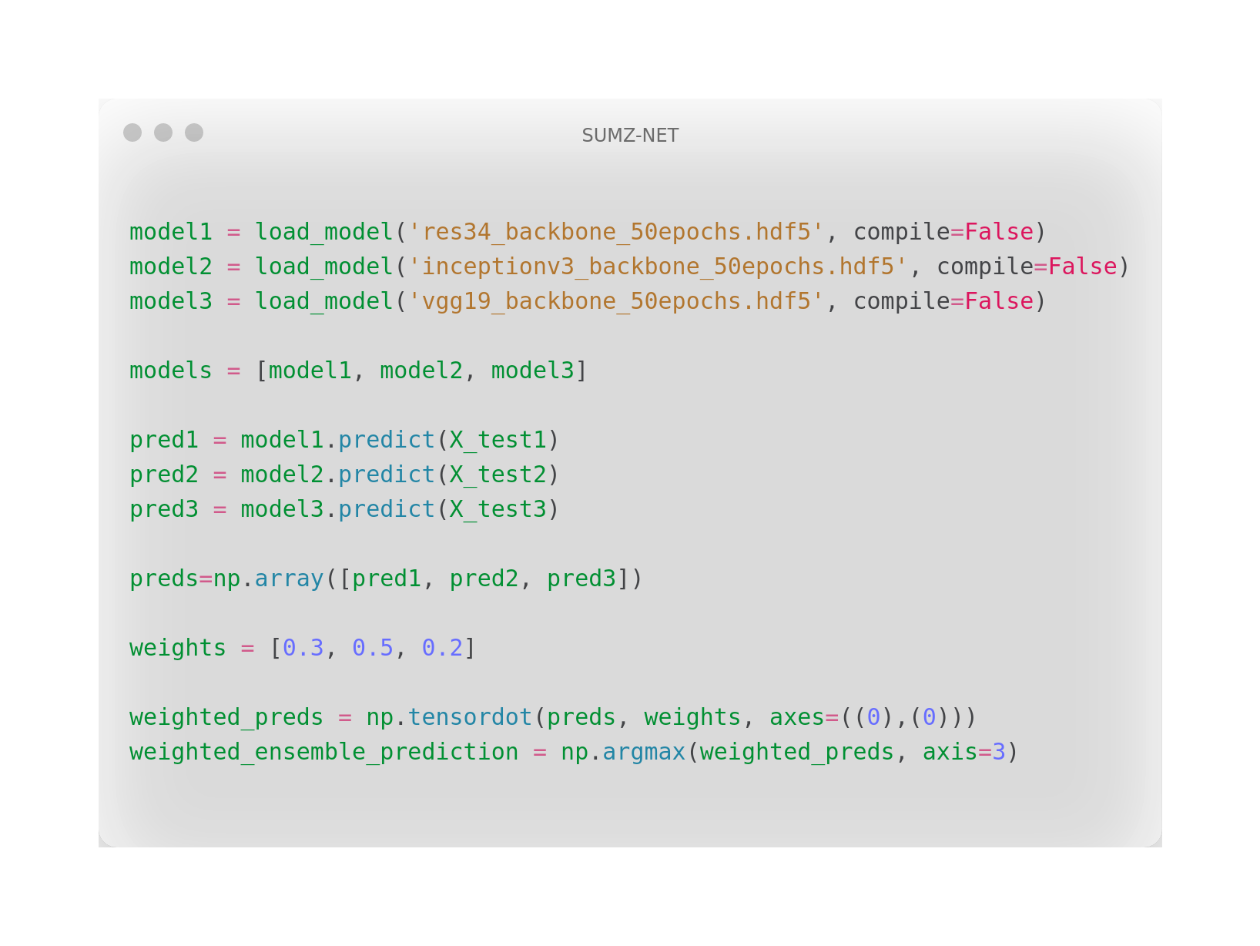
Notes:
ZAIN

Slide 14
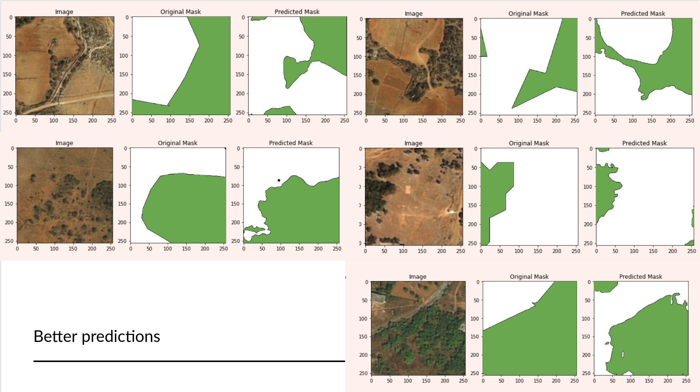
Better predictions
Notes:
MALIKA

Slide 15
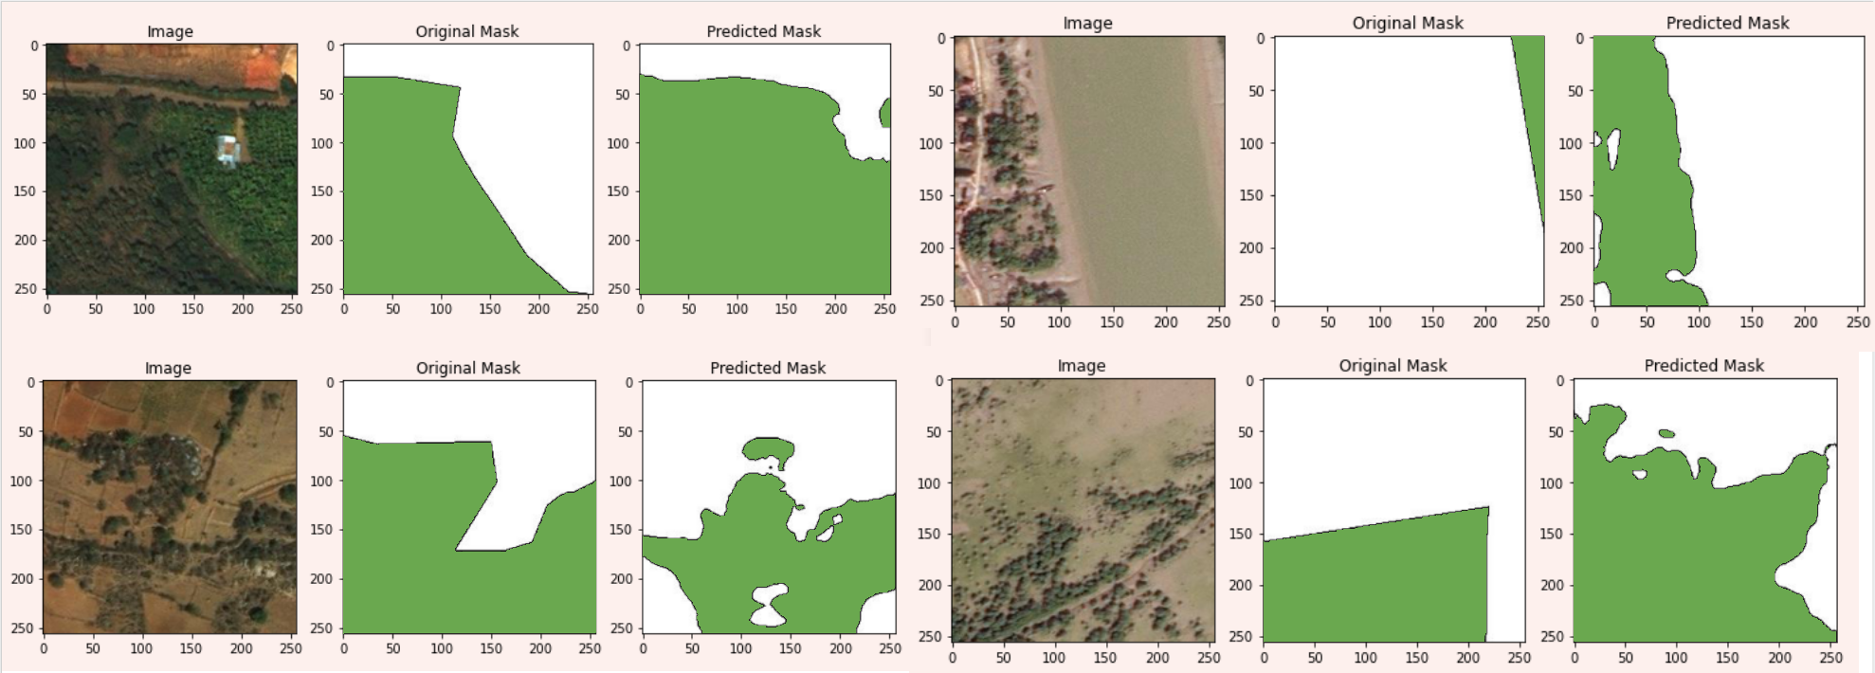
Interesting predictions
Notes:
SIMON

Slide 16
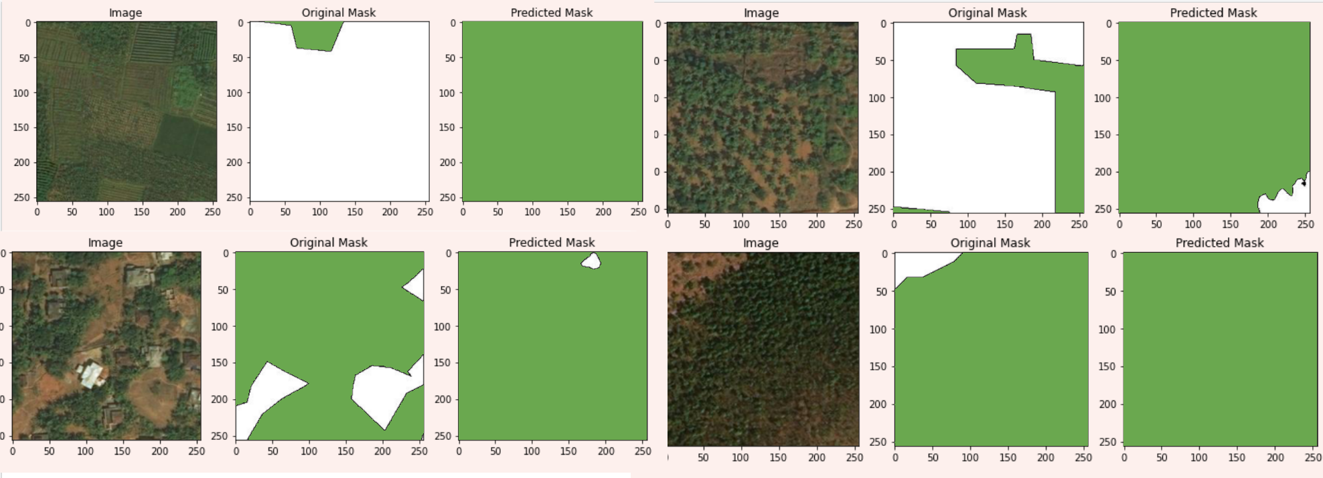
Worse predictions
Notes:
MALIKA

Slide 17
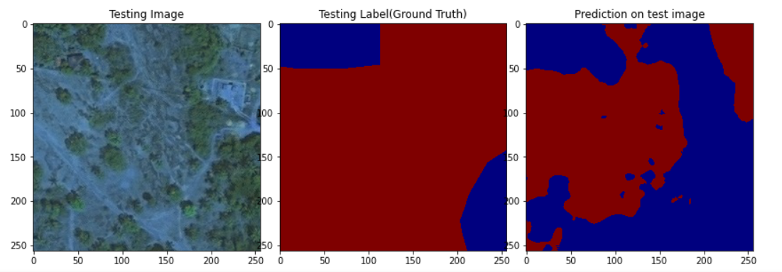
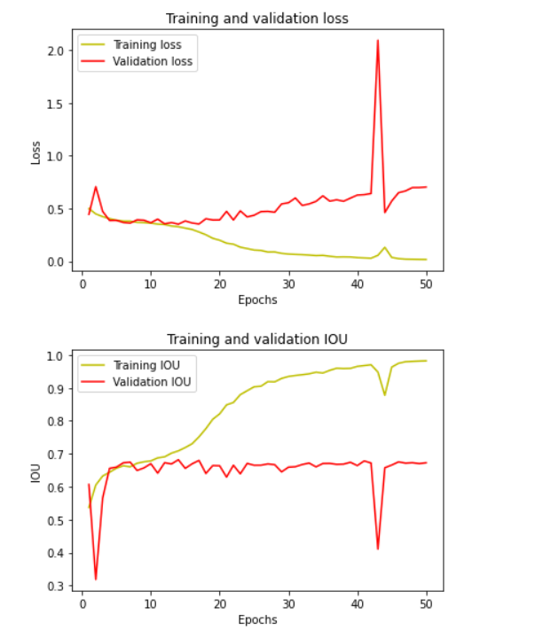
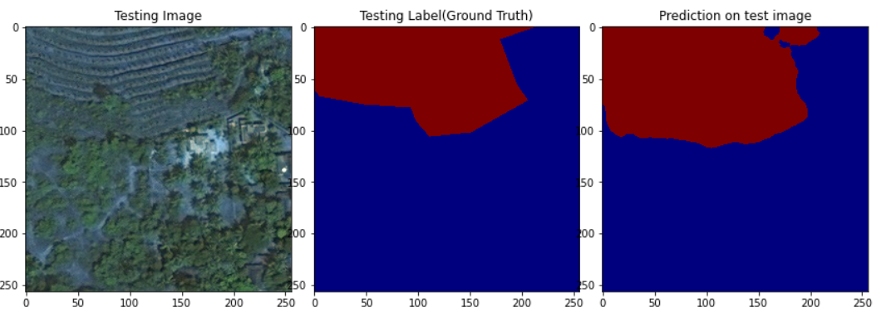
Prediction with Bad IoU
Prediction with Good IoU

Slide 18
scores:
F1-Score(average) : 71.01
IoU(average) : 68
Notes:
ZAIN

Slide 19
Problems Encountered
Setting up of GPU for training
Lack of available training data
Low quality of training data(inaccurately labeled masks)
The training was unstable; needed to increase batch size but unable due to GPU limitations
Notes:
URVASHI

Slide 20
Thank You!
Notes:
URVASHI

